Slide 1

Introduction to raspberry pi.
prepared for Lowell Makes
By, @leftyfb

Slide 2
Contents
Raspberry Pi
Linux
Boot up
Basic Linux
using the GPIO

Slide 3
Raspberry Pi
From Wikipedia:
“The Raspberry Pi is a series of credit card-sized single-board computers developed in the UK by the Raspberry Pi Foundation with the intention of promoting the teaching of basic computer science in schools”
The Model-B went on sale on the 29th February 2012 (The Model-A
in February 2013). There are currently millions of Raspberry Pi owners worldwide. The bulk of Raspberry Pi computers are produced in Pencoed, South Wales

Slide 4
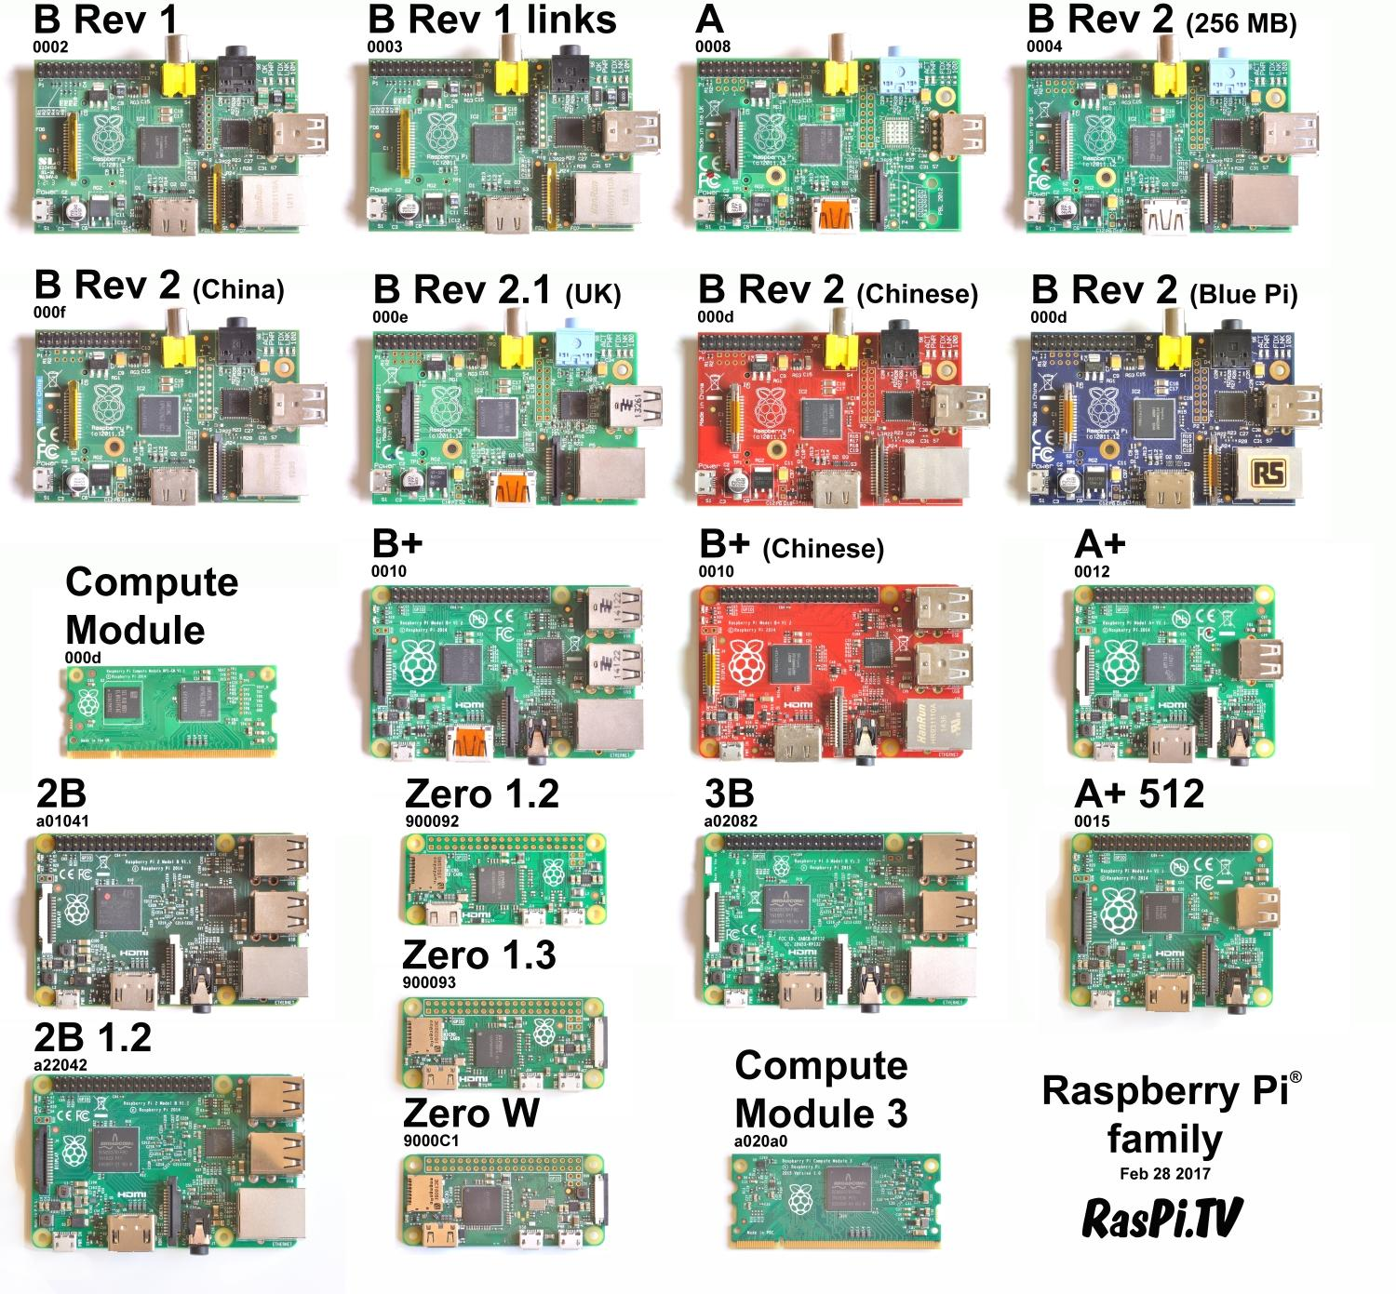
Raspberry Pi

Slide 5
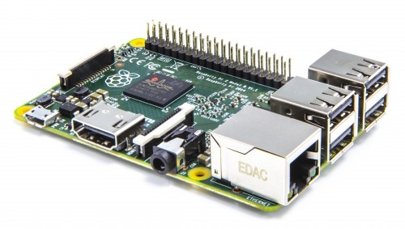
Raspberry Pi 3
1.2 GHZ quad-core ARM Cortex A53 (ARMv8 Instruction Set)
1 GB LPDDR2-900 SDRAM
USB ports: 4
Network: 10/100 MBPS Ethernet, 802.11n Wireless LAN, Bluetooth 4.0
Because it has an ARMv8 processor, it can run the full range of ARM GNU/Linux distributions, including Snappy Ubuntu Core, as well as Microsoft Windows 10.

Slide 6
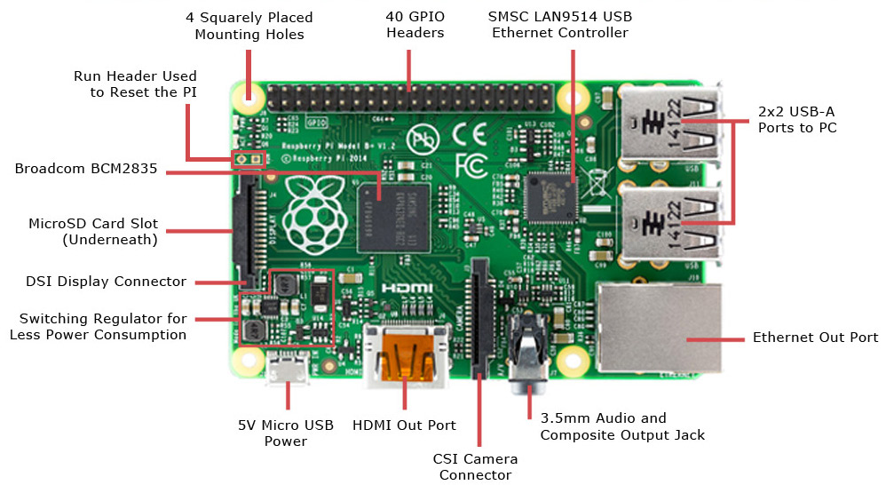
Raspberry Pi 3

Slide 7

Linux
Why linux?
GNU/Linux is a Free Operating system
GNU Project started in 1984 to create "free" Operating System
Linux Kernel (base of the system) created by Linus Torvalds in 1991
What can you do?
Freedom to use
Freedom to examine
Freedom to redistribute
Freedom to modify
What can't you do?
Deny these freedoms to anyone else

Slide 8
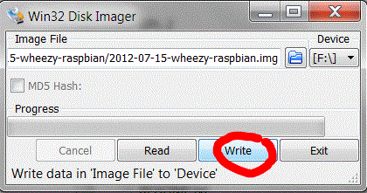
Image your SD card
Linux/Mac:
sudo dd if=path_of_your_image.img of=/dev/diskn bs=1M
Windows:
download Win32 Disk Imager (http://sourceforge.net/projects/win32diskimager/)

Slide 9
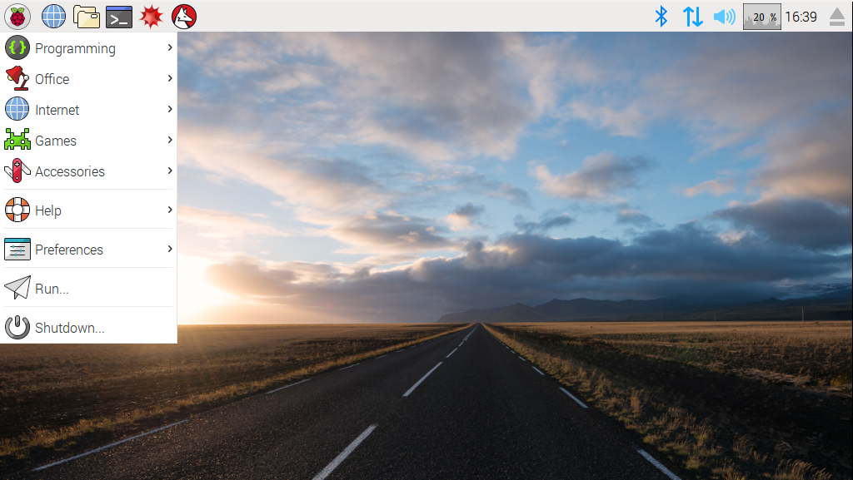
Boot your Pi

Slide 10
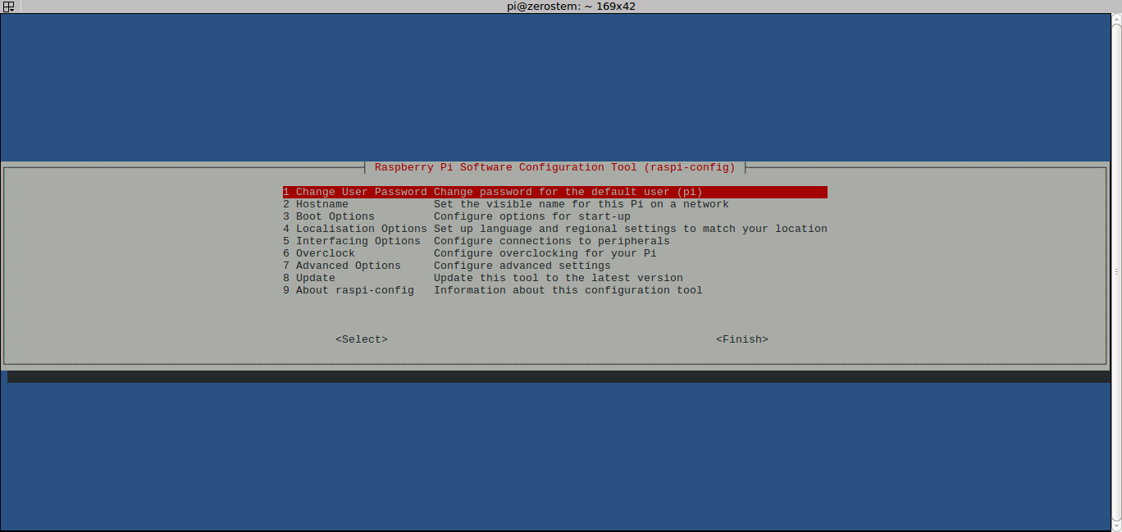
Raspi-config

Slide 11
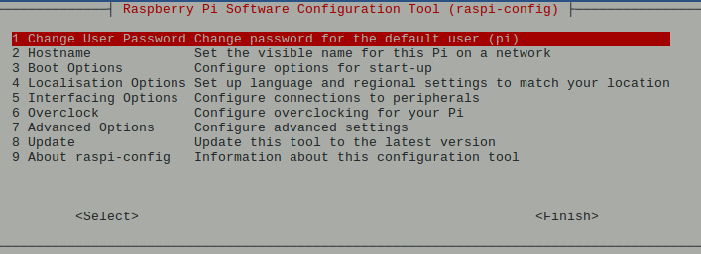
Raspi-config – Change Password

Slide 12
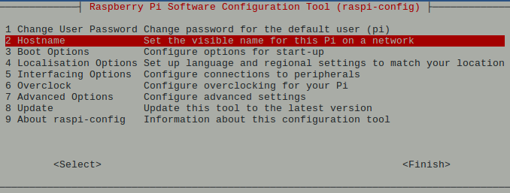
Raspi-config - Hostname

Slide 13
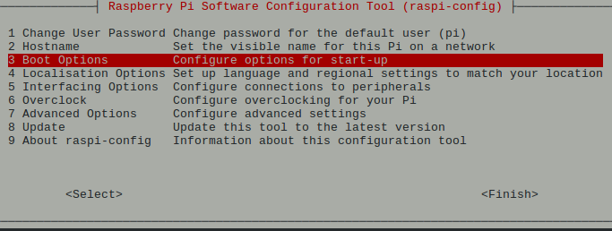
Raspi-config – Boot options

Slide 14
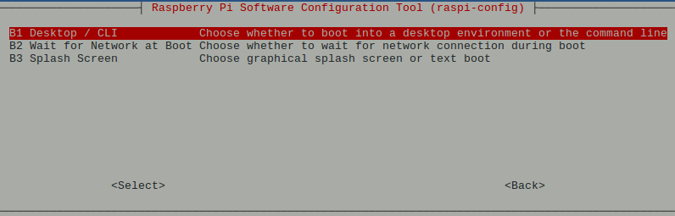
Raspi-config – Boot options

Slide 15
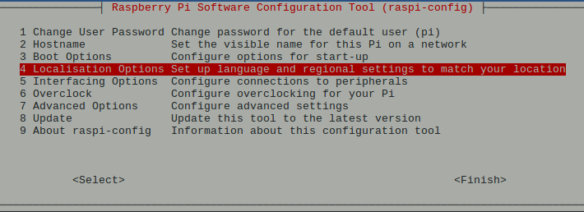
Raspi-config – Localisation Options

Slide 16
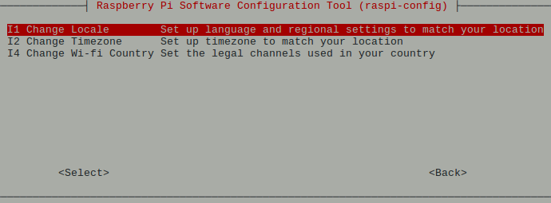
Raspi-config – Localisation Options

Slide 17
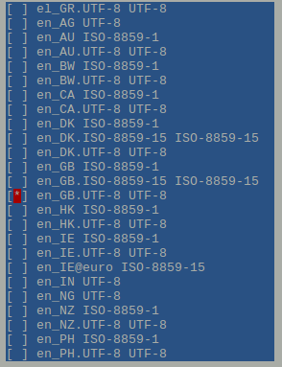
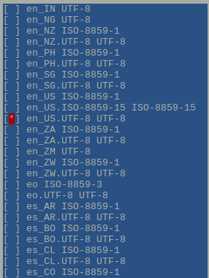
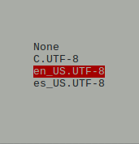
Raspi-config – Locale
Deselect en_GB.UFT-8 | Select en_US.UTF-8 | Select en_US.UTF-8

Slide 18
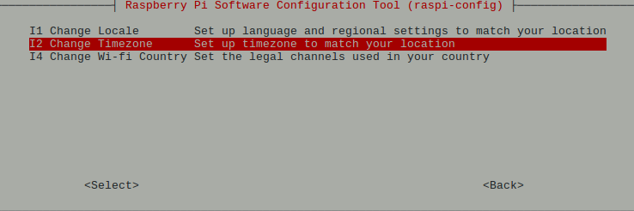
Raspi-config - Timezone

Slide 19
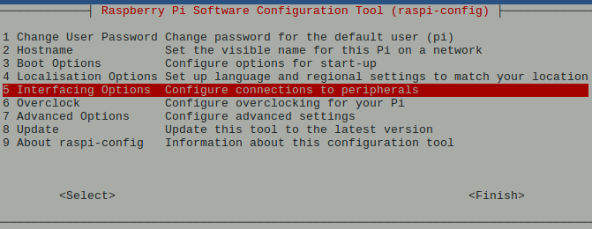
Raspi-config – Interfacing Options

Slide 20
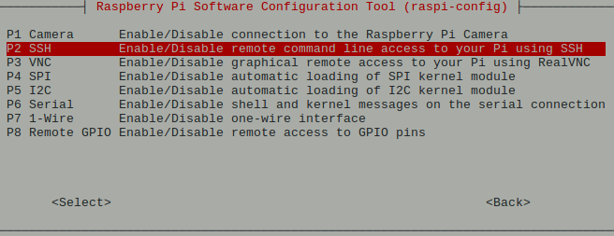
Raspi-config – SSH

Slide 21
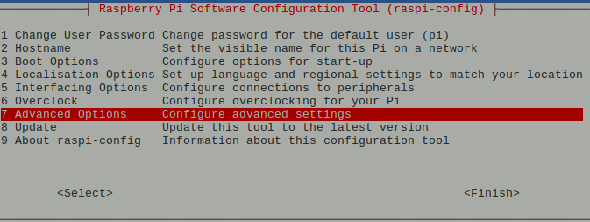
Raspi-config – Advanced Options

Slide 22
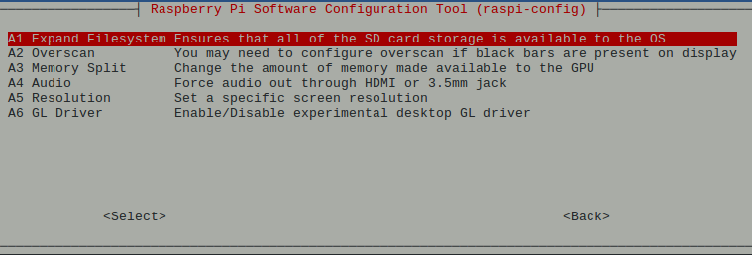
Raspi-config – Expand Filesystem
Note: The latest version of Raspbian will do this by default now.

Slide 23
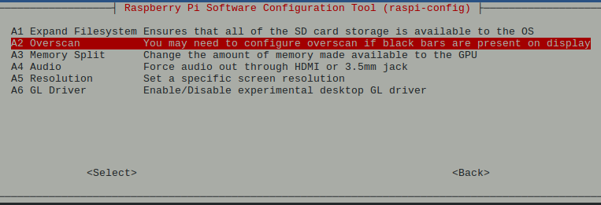
Raspi-config – Overscan

Slide 24
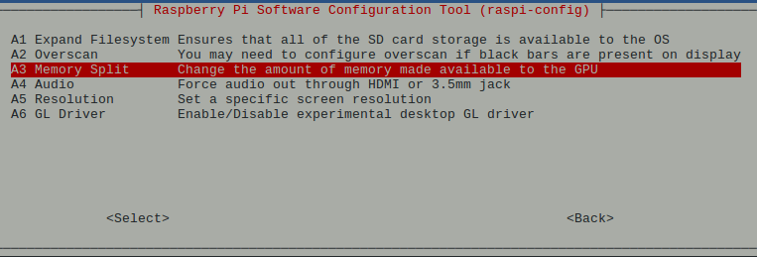
Raspi-config – Memory Split

Slide 25
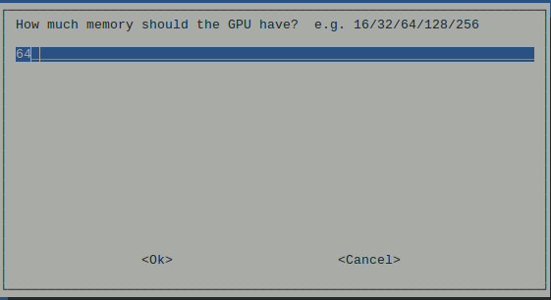
Raspi-config – Memory Split

Slide 26
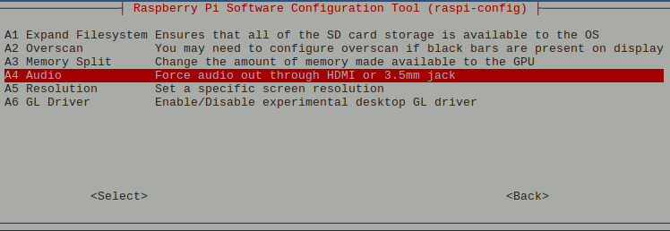
Raspi-config – Audio

Slide 27
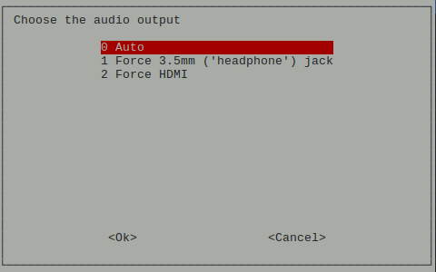
Raspi-config – Audio

Slide 28
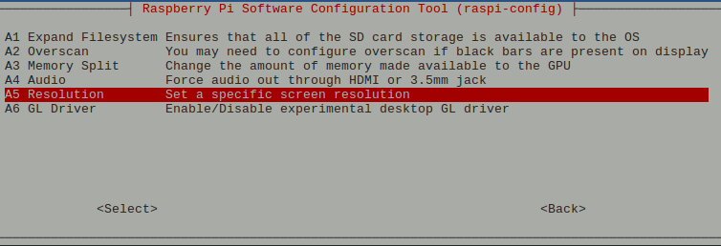
Raspi-config – Resolution

Slide 29
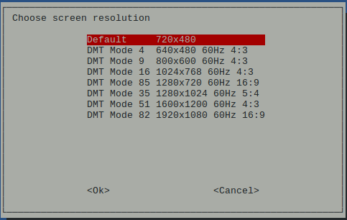
Raspi-config – Resolution

Slide 30
Find your way around Linux
ls
cd
.files
mkdir
echo
;
>
cat
tail
head
nano
while true
variables
if statements

Slide 31
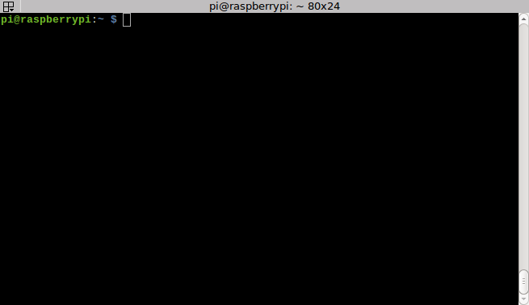
Terminal

Slide 32
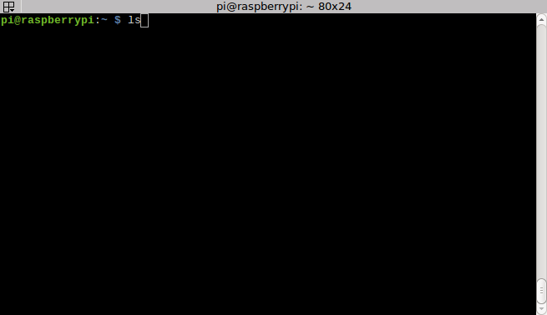
ls

Slide 33
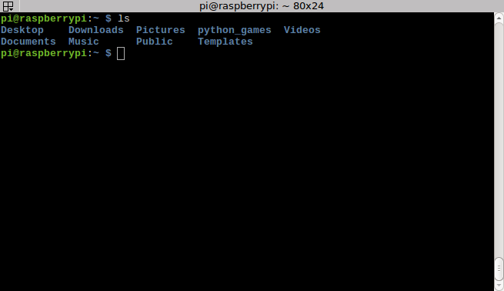
ls

Slide 34
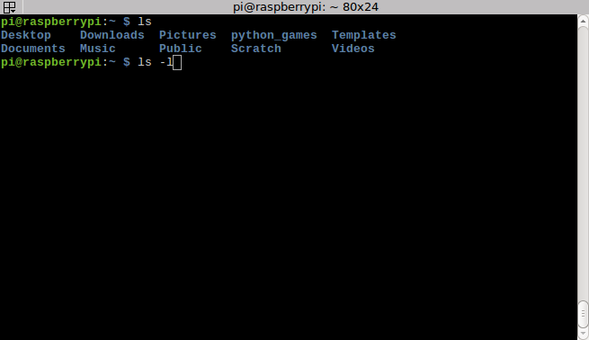
ls -l

Slide 35
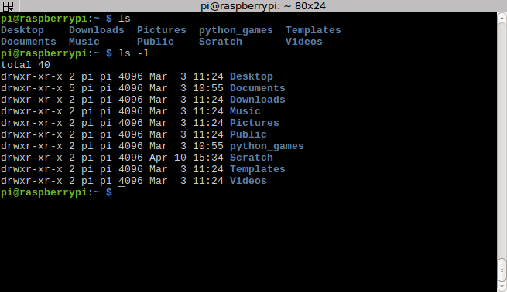
ls -l

Slide 36
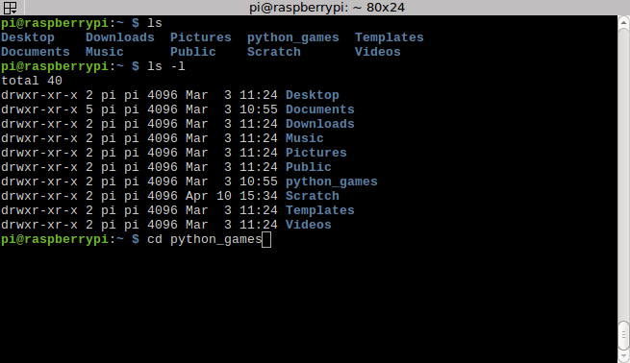
cd

Slide 37
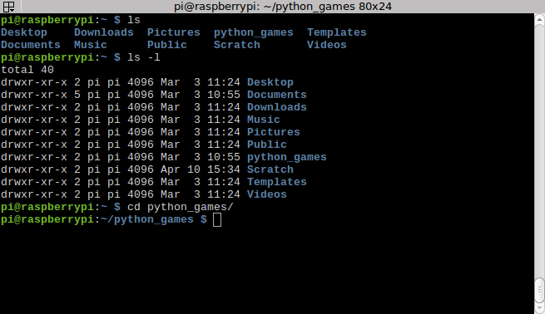
cd

Slide 38
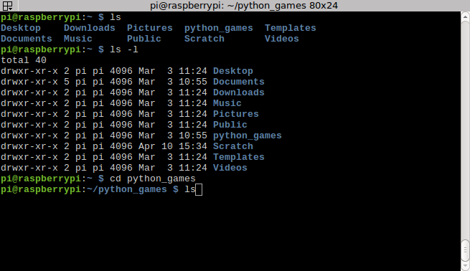
cd

Slide 39
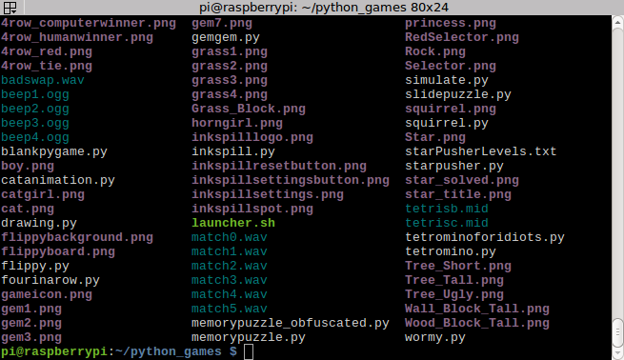
cd

Slide 40
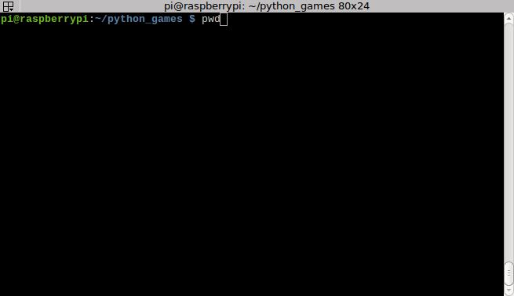
cd/pwd

Slide 41
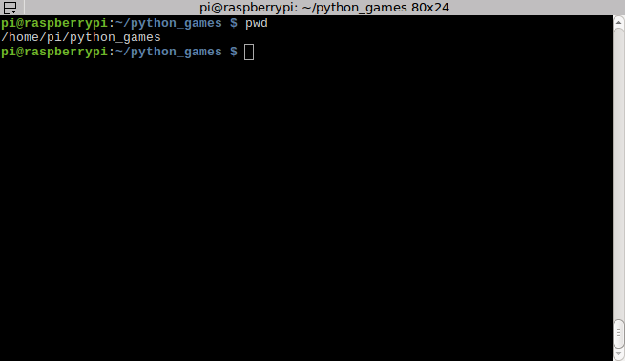
cd/pwd

Slide 42
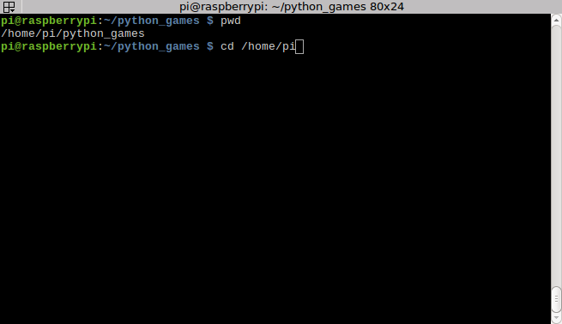
cd/pwd

Slide 43
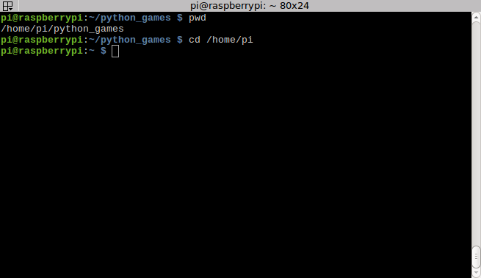
cd/pwd

Slide 44
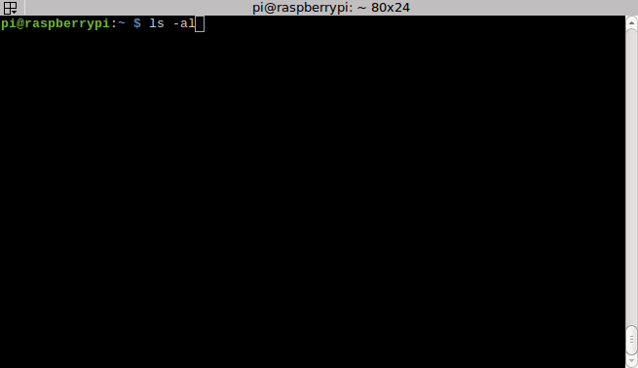
.files (dotfiles)

Slide 45
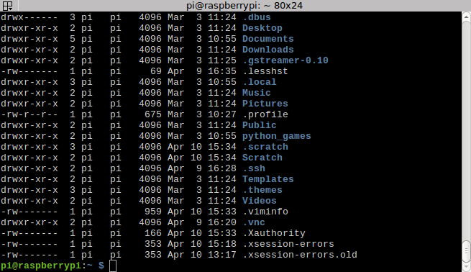
.files (dotfiles)

Slide 46
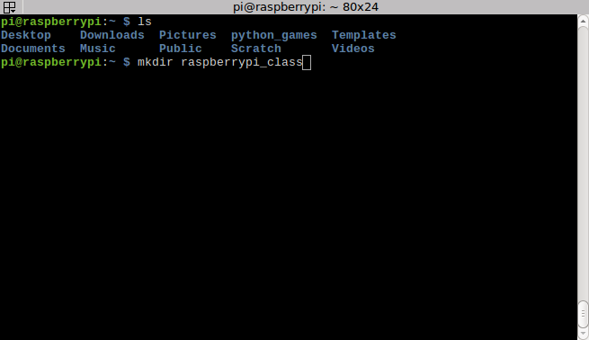
mkdir

Slide 47
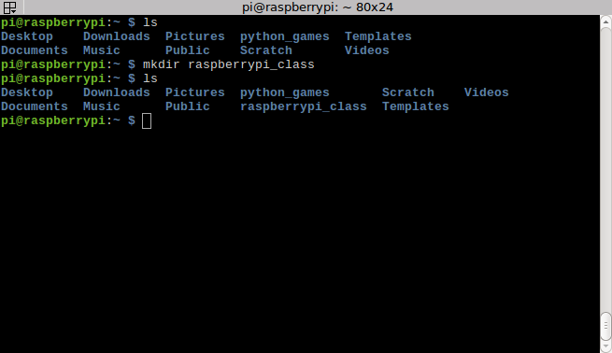
mkdir

Slide 48
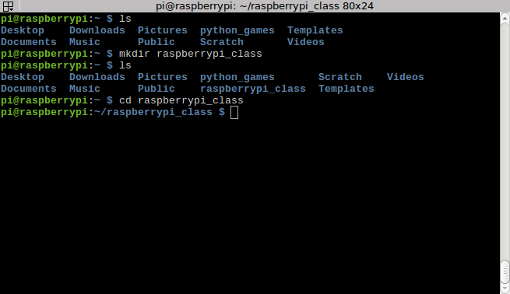
mkdir

Slide 49
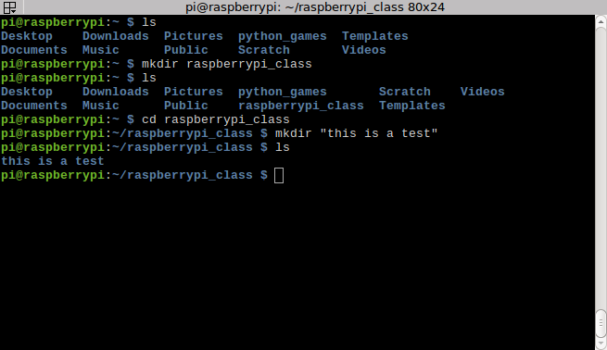
mkdir

Slide 50
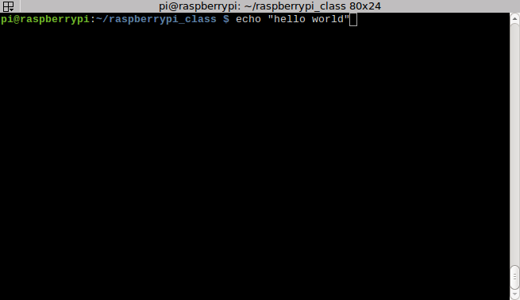
echo

Slide 51
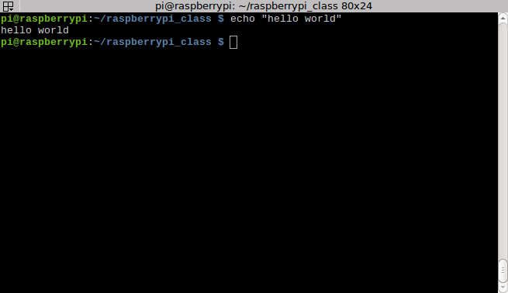
echo

Slide 52
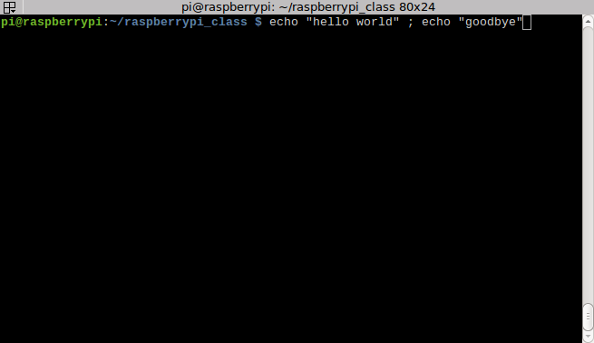
Command separator [semicolon]

Slide 53
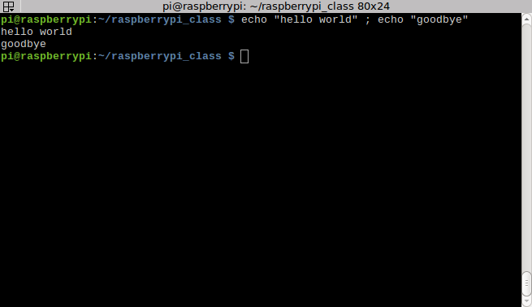
Command separator [semicolon]

Slide 54

I/O Redirection

Slide 55

I/O Redirection

Slide 56

cat

Slide 57

cat

Slide 58

cat

Slide 59

cat

Slide 60

tail

Slide 61

tail

Slide 62

tail

Slide 63

head

Slide 64

head

Slide 65

nano

Slide 66

nano

Slide 67

nano

Slide 68

nano

Slide 69

nano

Slide 70

nano

Slide 71

while loop (while true)

Slide 72

while loop (while true)

Slide 73

while loop (while true)

Slide 74

while loop (while true)

Slide 75

while loop (while true)

Slide 76

while loop (while true)

Slide 77

chmod

Slide 78

chmod

Slide 79

while loop (while true)

Slide 80

while loop (while true)

Slide 81

while loop (while true)

Slide 82

$variables

Slide 83

$variables

Slide 84

$variables

Slide 85

$variables

Slide 86

$variables

Slide 87

If statements

Slide 88

If statements

Slide 89

If statements

Slide 90

If statements

Slide 91

If statements

Slide 92

If statements

Slide 93

If statements

Slide 94

If statements

Slide 95

If statements

Slide 96

If statements

Slide 97

If statements

Slide 98

Pi GPIOs

Slide 99

Pi GPIOs
GPIO (40)
SPI (3)
I²C (2)
UART (1)
PWM (1)

Slide 100

Breadboard

Slide 101

T-Cobbler Plus

Slide 102

LED

Slide 103

LED

Slide 104

GPIO (gpio command)

Slide 105

GPIO (gpio command)

Slide 106

GPIO (gpio command)

Slide 107

GPIO (gpio command)

Slide 108

GPIO (gpio command)

Slide 109

Blink LED!

Slide 110

Blink LED!

Slide 111

Blink LED!

Slide 112

Blink LED!

Slide 113

Blink LED!

Slide 114
Blink LED!
Can you make 2 LED’s blink in opposing patterns using 1 GPIO pin?

Slide 115
Blink LED!
Can you make 2 LED’s blink in opposing patterns using 1 GPIO pin?
Hint: What is GPIO #4 set to when the LED is “off”?

Slide 116

Blink LED!
Can you make 2 LED’s blink in opposing patterns using 1 GPIO pin?
Hint: What is GPIO #4 set to when the LED is “off”?

Slide 117

Switch/Button
With a pull-up resistor, the input pin will read a high state when the button is not pressed. In other words, a small amount of current is flowing between VCC and the input pin (not to ground), thus the input pin reads close to VCC. When the button is pressed, it connects the input pin directly to ground.

Slide 118

Switch/Button
Button → GPIO #26
Button → Ground

Slide 119

Switch/Button

Slide 120

Switch/Button

Slide 121

Switch/Button

Slide 122

Switch/Button

Slide 123

Pi GPIO
Blink LED

Slide 124
Pi GPIO
Blink LED
1a. Bonus
Try to blink 2 LED’s using
only 1 GPIO pin.

Slide 125
Pi GPIO
Blink LED
1a. Bonus
Try to blink 2 LED’s using
only 1 GPIO pin.
Hint: What happens to
the GPIO pin when the
LED is not lit?

Slide 126

Pi GPIO
Blink LED
1a. Bonus
Try to blink 2 LED’s using
only 1 GPIO pin.
Hint: What happens to
the GPIO pin when the
LED is not lit?
Push Button

Slide 127
Questions?

